Slide 1

Chisholm Trail Volleyball
Important Summer Information 2026

Slide 2
Coaching Staff
Janine Smith– Varsity Head Coach
jsmith@ems-isd.net
Andrea Sandefer – Assistant Coach
asandefer@ems-isd.net

Slide 3
Getting Ready for Tryouts
Physicals
Summer Conditioning
Summer Camp
Summer League

Slide 4
Physicals
Every athlete needs a current physical on file at Chisholm Trail High School before you can participate in tryouts. Earliest Date on physical to deem current is May 1st
WHO NEEDS A PHYSICAL?
ALL INCOMING and RETURNING PLAYERS
You will need PHYSICAL, MEDICAL HISTORY FORM, AND ALL RANKONE ELECTRONIC FORMS COMPLETED BEFORE YOU TRYOUT
ALL ATHLETES MUST COMPLETE ONLINE REGISTRATION
HTTP://WWW.RANKONESPORT.COM
Information on Student Accident insurance can be found here:
https://www.emsisd.com/Page/35230

Slide 5
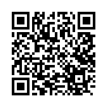
Summer Conditioning
Volleyball Conditioning
Offered at Chisholm Trail High School
Training WEIGHTS AND CONDITIONING/SKILL TRAINING CAMP
8-10 TRAINING AT FIELD HOUSE 10-11 TRAINING AT CTHS GYM
Dates/Time: Starting JUNE 1ST-JULY 24TH
Monday -Thursday
8:00-11:00
This camp is going to be run by CTHS/EMSISD Coaches. In order to participate you need to fill out Strength and Conditioning form online. Scan the QR Code

Slide 6
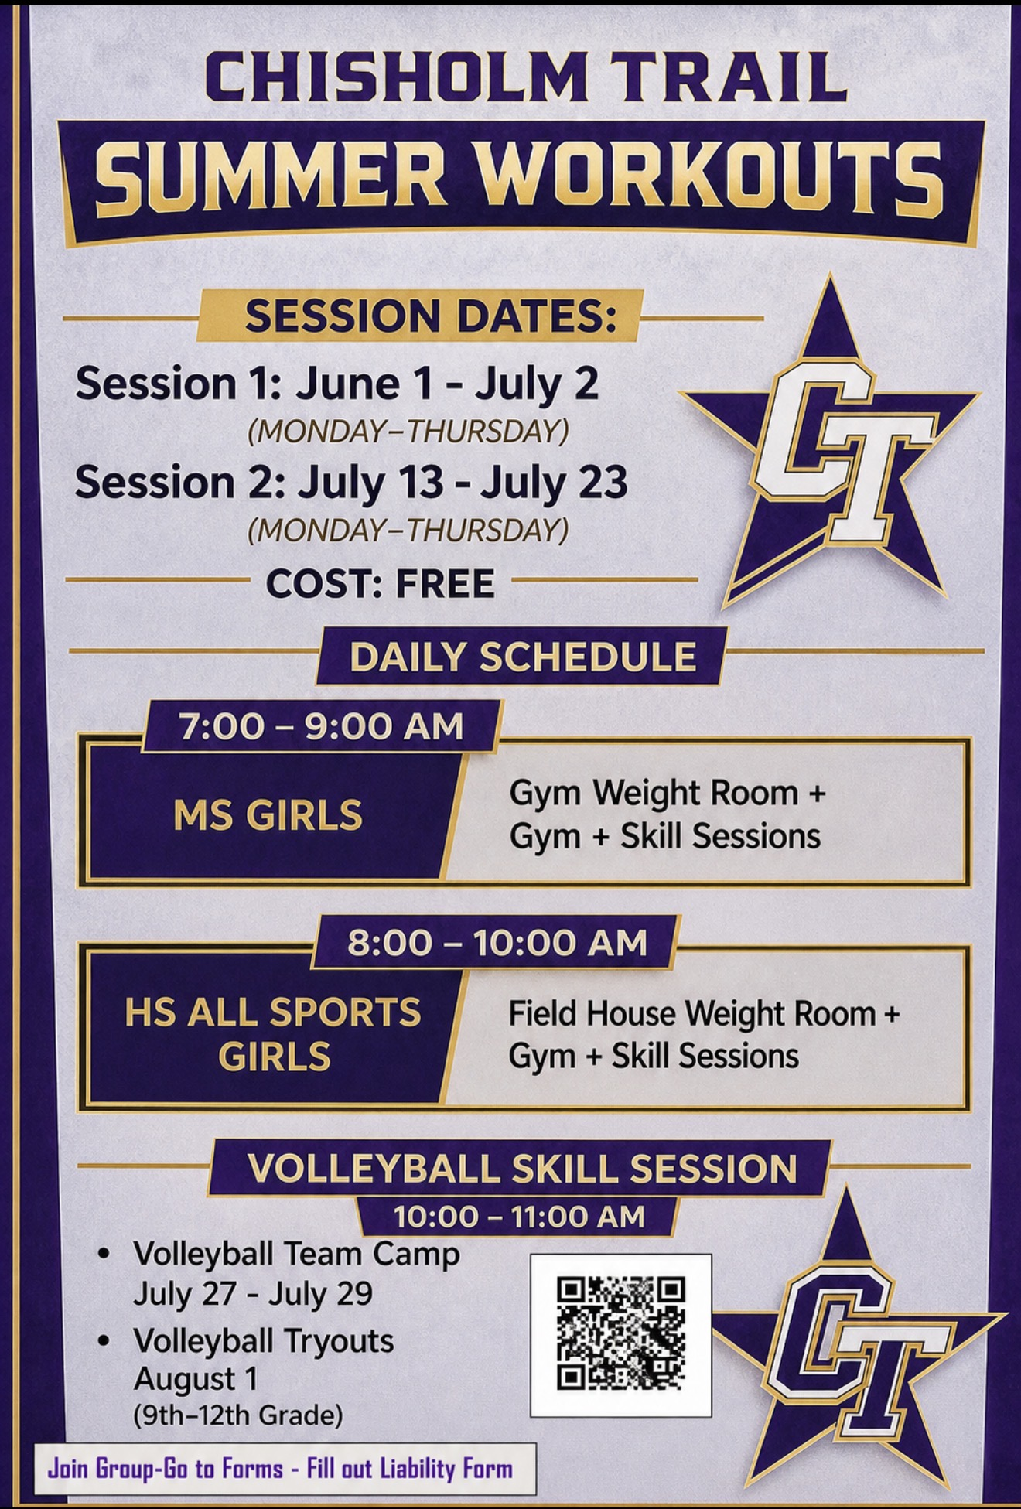
Summer Weight/Conditioning/Skill Training

Slide 7
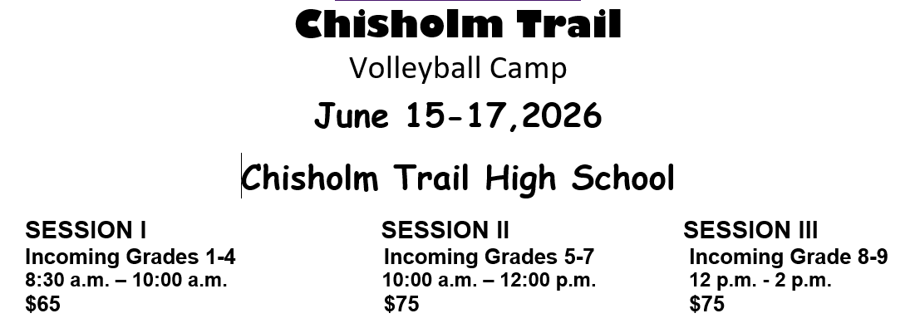
Summer Camp
Grades 1-8 and
Incoming 9th Graders
Held at Chisholm High School
Online Registration (District Website)
https://emsisd.revtrak.net

Slide 8
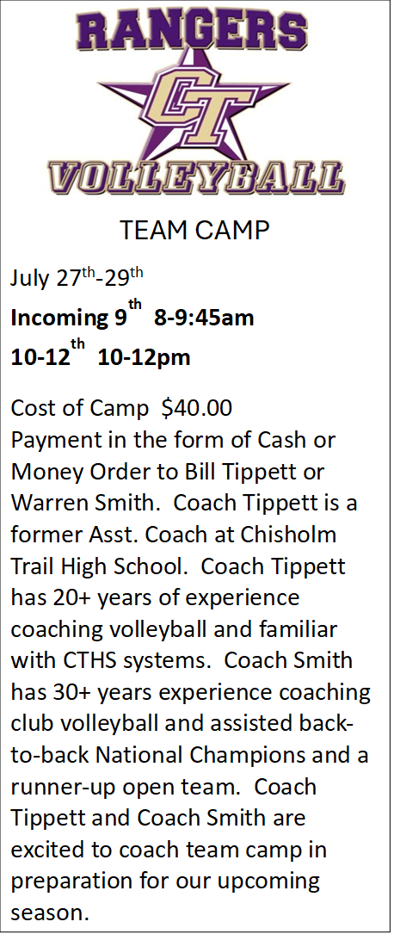
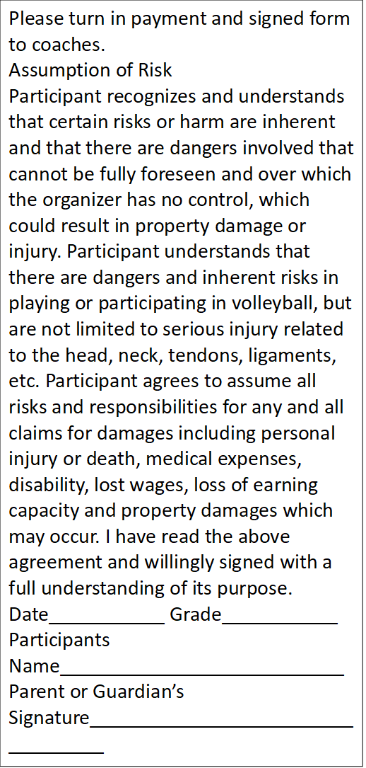
Team Competitive/Summer Camp

Slide 9
Tryouts/Schedules
TRYOUTS
Start SATURDAY AUGUST 1ST
SATURDAY AUGUST 1ST 9:00-11:00 and 1:00-4:00
MONDAY AUGUST 3RD TRYOUT AT MARINE CREEK MIDDLE SCHOOL 9-11AM
MONDAY PM TRYOUT AT CHISHOLM TRAIL HIGH SCHOOL AFTER CONVOCATION. APPROX. 4-7PM
Tryouts/practice 8-10am, 4-7pm until school starts (times subject to change due to teacher professional development)
Scrimmages start
Friday August 7th (Cleburne)
Saturday August 8th (Keller Timber Creek)

Slide 10
Volleyball Booster Club
Brandi Hoyle President
Jennifer Gonzales– Volleyball Rep
We will need team representatives to help out with team meals and general organization and communication.

Slide 11
Booster Club
Booster Club Needs Our Participation
We will need Team Parent Reps, concession stand , and special event volunteers.
Work Opportunities, Scholarship Fund, Banquet, Etc.
The ability to provide nice things for our program would not be possible without the Booster Club!

Slide 12
Partners/Fundraising
Fundraising
EMSISD Sub Varsity Tournament September 5th
Middle School Madness Tournament September 12th
Expectation is that everyone in the program will work these events. Middle School Madness is our BIG fundraiser!! We expect student and parent involvement on this day. EMSISD is projected to be hosted by all campuses. We will be a site host and all high schools will split profit.
We have had 90 plus teams enter Middle School Madness Tournament in the past so it is imperative that we have Program Wide Involvement on this day.

